Slide 1
HOW TO CONNECT THE THREE DOTS
 CPEC  KARACHI CITY &  BUSINESS EDUCATION



Remarks by Dr. Ijaz Shafi Gilani
Chairman Gallup Pakistan/ Gilani Research Foundation
KARACHI February 5, 2018

Slide 2
My Take-home
 CPEC  KARACHI CITY &  BUSINESS EDUCATION: How to connect the Three Dots Remarks by Dr Ijaz Shafi Gilani, (February.05, 2018 Karachi)
CORPORATE GOVERNANCE OF PAKISTAN'S TOP 30 CITIES

Slide 3
 CPEC  KARACHI CITY &  BUSINESS EDUCATION: How to connect the Three Dots Remarks by Dr Ijaz Shafi Gilani, (February.05, 2018 Karachi)
WHAT IS THE LOGIC

Slide 4
 CPEC  KARACHI CITY &  BUSINESS EDUCATION: How to connect the Three Dots Remarks by Dr Ijaz Shafi Gilani, (February.05, 2018 Karachi)
THE DIALECTIC OF IDEAS PRACTICE AND POWER

Slide 5
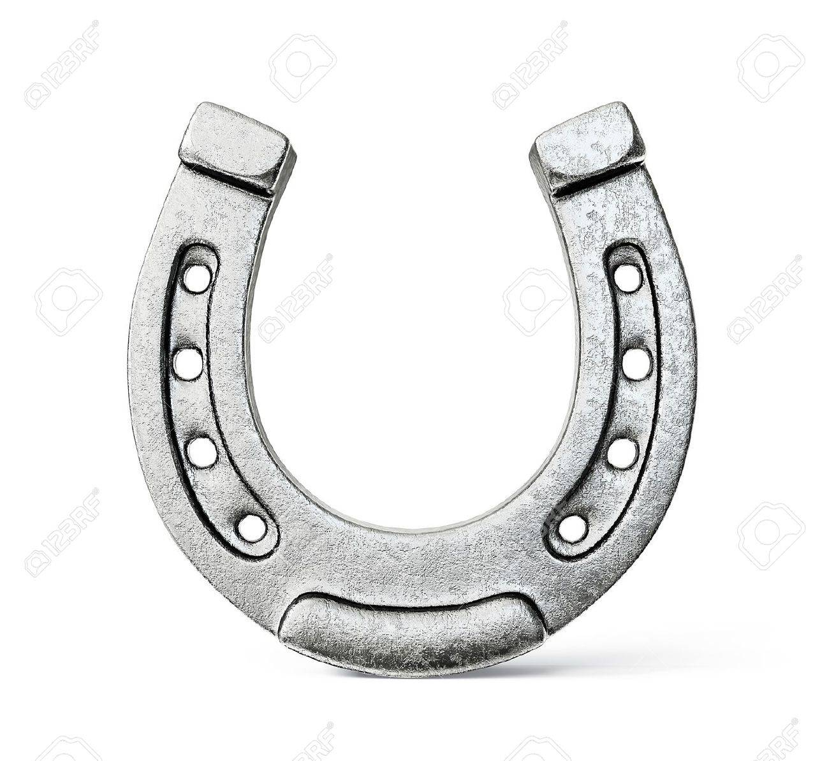
Dialectic # 1
 CPEC  KARACHI CITY &  BUSINESS EDUCATION: How to connect the Three Dots Remarks by Dr Ijaz Shafi Gilani, (February.05, 2018 Karachi)
For 30 Years (Since ~ 1990) there is a Trend
CORPORATIZATION OF GOVERNMENT BUREAUCRATIZATION OF CORPORATION
Like a Horse-Shoe the two seem to be coming together

Slide 6
Dialectic # 2
 CPEC  KARACHI CITY &  BUSINESS EDUCATION: How to connect the Three Dots Remarks by Dr Ijaz Shafi Gilani, (February.05, 2018 Karachi)
POWER SHIFT
World Map
FROM WEST TO THE REST

Slide 7
 CPEC  KARACHI CITY &  BUSINESS EDUCATION: How to connect the Three Dots Remarks by Dr Ijaz Shafi Gilani, (February.05, 2018 Karachi)
GDP Share %
Across Euro-Americas and Afro-Asia(Year 1000—2014)
Source: OECD (for 1000-2003) and World Bank (for 2014)
Note: Please note that the longitudinal landmarks are not proportionately equi-distant from each other. The present exhibits are for ease of communication only. The exact data may please be seen in the tabular representations of the exhibits succeeding the line graphs.

Slide 8
 CPEC  KARACHI CITY &  BUSINESS EDUCATION: How to connect the Three Dots Remarks by Dr Ijaz Shafi Gilani, (February.05, 2018 Karachi)
QUARTER (OF A CENTURY) OF SWIFT CHANGE
% Share in GNI
(Year 1990-2015)
Source: World Development Indicators – World Bank

Slide 9
 CPEC  KARACHI CITY &  BUSINESS EDUCATION: How to connect the Three Dots Remarks by Dr Ijaz Shafi Gilani, (February.05, 2018 Karachi)
% Share in GNI – 4 BIG ECONOMIES
G-7 Countries: TREND over 25 Years
(Year 1990-2015)
Source: World Development Indicators – World Bank

Slide 10
 CPEC  KARACHI CITY &  BUSINESS EDUCATION: How to connect the Three Dots Remarks by Dr Ijaz Shafi Gilani, (February.05, 2018 Karachi)
GLOBAL TRADE Trend Data (1988-2015)
From 1.3 Trillion USD to 37.2 Trillion in 2014
 | Global Value in US$ Thousands | % Share in Global Trade ( Imports + Exports)
 |  | Asia | Africa | Americas | Europe | Euro- America | Afro- Asia
1988 | 1,313,246,887 | 27 | 2 | 23 | 48 | 71 | 29
1989 | 2,107,915,283 | 29 | 2 | 28 | 42 | 70 | 30
1990 | 2,489,519,939 | 28 | 1 | 27 | 43 | 70 | 30
1991 | 3,558,059,123 | 32 | 2 | 29 | 38 | 67 | 33
1992 | 4,545,960,415 | 31 | 1 | 27 | 41 | 68 | 32
1993 | 5,293,259,302 | 33 | 1 | 27 | 39 | 66 | 34
1994 | 7,036,989,429 | 30 | 1 | 26 | 43 | 68 | 32
1995 | 8,773,598,604 | 29 | 1 | 24 | 45 | 69 | 31
1996 | 9,399,795,491 | 29 | 2 | 24 | 45 | 70 | 30
1997 | 10,028,585,026 | 29 | 1 | 26 | 44 | 69 | 31
1998 | 9,930,392,450 | 27 | 1 | 26 | 46 | 72 | 28
1999 | 10,638,918,534 | 27 | 1 | 26 | 46 | 72 | 28
2000 | 12,973,404,467 | 30 | 2 | 27 | 42 | 69 | 31
2001 | 12,553,064,484 | 29 | 2 | 26 | 43 | 69 | 31
2002 | 13,121,614,804 | 30 | 2 | 25 | 43 | 69 | 31
2003 | 15,367,543,814 | 31 | 2 | 23 | 45 | 68 | 32
2004 | 18,636,932,324 | 31 | 2 | 22 | 45 | 67 | 33
2005 | 21,020,312,648 | 32 | 2 | 22 | 44 | 66 | 34
2006 | 24,308,998,205 | 33 | 2 | 22 | 44 | 65 | 35
2007 | 28,019,247,075 | 33 | 2 | 20 | 45 | 65 | 35
2008 | 32,175,236,139 | 34 | 2 | 20 | 44 | 64 | 36
2009 | 25,054,601,944 | 35 | 2 | 20 | 43 | 62 | 38
2010 | 30,461,181,072 | 37 | 2 | 20 | 40 | 60 | 40
2011 | 36,117,611,004 | 37 | 3 | 20 | 40 | 60 | 40
2012 | 36,219,024,116 | 39 | 3 | 20 | 39 | 59 | 41
2013 | 37,176,727,969 | 38 | 3 | 20 | 39 | 59 | 41
2014 | 37,274,705,980 | 39 | 3 | 20 | 39 | 59 | 41
2015 | 30,065,233,089 | 38 | 2 | 21 | 39 | 60 | 40
GLOBAL SHIFT (1988-2015) |  | 11 | 0 | -3 | -9 | -11 | 11
Source: http://wits.worldbank.org/CountryProfile/en/Country/WLD/StartYear/2011/EndYear/2015/TradeFlow/Export/Partner/BY-REGION/Indicator/XPRT-TRD-VL#
Source: World Integrated Trade Solutions – World Bank

Slide 11
 CPEC  KARACHI CITY &  BUSINESS EDUCATION: How to connect the Three Dots Remarks by Dr Ijaz Shafi Gilani, (February.05, 2018 Karachi)
GLOBAL Shift in TRADE (1988-2015)
Source: World Integrated Trade Solutions – World Bank
Note: Please note that the longitudinal landmarks are not proportionately equi-distant from each other. The present exhibits are for ease of communication only. The exact data may please be seen in the tabular representations of the exhibits succeeding the line graphs.

Slide 12
 CPEC  KARACHI CITY &  BUSINESS EDUCATION: How to connect the Three Dots Remarks by Dr Ijaz Shafi Gilani, (February.05, 2018 Karachi)
CHINA’S TRADE DEFICIT WITH LEADING ECONOMIC POWERS
COUNTRY | TRADE DEFICIT (US$) (2015)
U.S.A | -387,841,915
U.K. | -35,354,205
GERMANY | -23,918,333
FRANCE | -31,961,569
JAPAN | -51,281,932

Slide 13
Dialectic # 3
 CPEC  KARACHI CITY &  BUSINESS EDUCATION: How to connect the Three Dots Remarks by Dr Ijaz Shafi Gilani, (February.05, 2018 Karachi)
RESOURCE SHIFT
FROM GLOBAL MOVEMENT OF MANPOWER TO GLOBAL SHIFT OF CAPITAL AND TECHNOLOGY

Slide 14
Dialectic # 4
 CPEC  KARACHI CITY &  BUSINESS EDUCATION: How to connect the Three Dots Remarks by Dr Ijaz Shafi Gilani, (February.05, 2018 Karachi)
TRIUMPH OF CITY OVER THE SUB-URBIA AND OF NETWORK OVER THE SPRAWL

Slide 15
 CPEC  KARACHI CITY &  BUSINESS EDUCATION: How to connect the Three Dots Remarks by Dr Ijaz Shafi Gilani, (February.05, 2018 Karachi)
CONSEQUENCES

Slide 16
# 1
 CPEC  KARACHI CITY &  BUSINESS EDUCATION: How to connect the Three Dots Remarks by Dr Ijaz Shafi Gilani, (February.05, 2018 Karachi)
CONNECTIVITY EMERGES AS THE DIALECTICAL DRIVER FOR SYNTHESIS

Slide 17
 CPEC  KARACHI CITY &  BUSINESS EDUCATION: How to connect the Three Dots Remarks by Dr Ijaz Shafi Gilani, (February.05, 2018 Karachi)
INFORMATION TECHNOLOGY TAKES THE LEAD TO CONNECT THE WORLD IT PROVIDES THE SOFTWARE OF CONNECTIVITY
Globalization.1 become the Vehicle led by the West

Slide 18
HARD-WARE OF CONNECTIVITY
 CPEC  KARACHI CITY &  BUSINESS EDUCATION: How to connect the Three Dots Remarks by Dr Ijaz Shafi Gilani, (February.05, 2018 Karachi)
PHYSICAL INFRASTRUCTURE TO CONNECT THE (HALF) FLAT WORLD WAS QUITE INEVITABLE

Slide 19
 CPEC  KARACHI CITY &  BUSINESS EDUCATION: How to connect the Three Dots Remarks by Dr Ijaz Shafi Gilani, (February.05, 2018 Karachi)
OTHER DIALECTICS REINFORCED THE TREND

Slide 20
 CPEC  KARACHI CITY &  BUSINESS EDUCATION: How to connect the Three Dots Remarks by Dr Ijaz Shafi Gilani, (February.05, 2018 Karachi)
OBOR-BELT AND ROAD INITIATIVE
PROVIDES THE
HARDWARE COMPONENT OF THE
DIGITAL REVOLUTION OR THE
SOFTWARE OF CONNECTIVITY

Slide 21
 CPEC  KARACHI CITY &  BUSINESS EDUCATION: How to connect the Three Dots Remarks by Dr Ijaz Shafi Gilani, (February.05, 2018 Karachi)
THE FIRST (Globalization.1)
WAS LED BY THE WEST

Slide 22
 CPEC  KARACHI CITY &  BUSINESS EDUCATION: How to connect the Three Dots Remarks by Dr Ijaz Shafi Gilani, (February.05, 2018 Karachi)
THE SECOND (Globalization.2) IS LED BY THE REST
The new or Neo-Globalization

Slide 23
 CPEC  KARACHI CITY &  BUSINESS EDUCATION: How to connect the Three Dots Remarks by Dr Ijaz Shafi Gilani, (February.05, 2018 Karachi)
WORLDWIDE OBOR PROJECTS
Total Projects : - 2,238
Projects Value : -$1,485,910,000,000
Source: American Enterprise Institute (updated on 7 Mar 2017)
https://www.aei.org/china-global-investment-tracker/

Slide 24
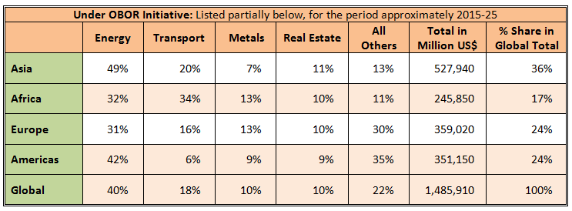
 CPEC  KARACHI CITY &  BUSINESS EDUCATION: How to connect the Three Dots Remarks by Dr Ijaz Shafi Gilani, (February.05, 2018 Karachi)
CHINA’S INVESTMENT IN GLOBAL INFRASTRUCTURE BUSINESS
Source: American Enterprise Institute (updated on 7 Mar 2017)
https://www.aei.org/china-global-investment-tracker/

Slide 25
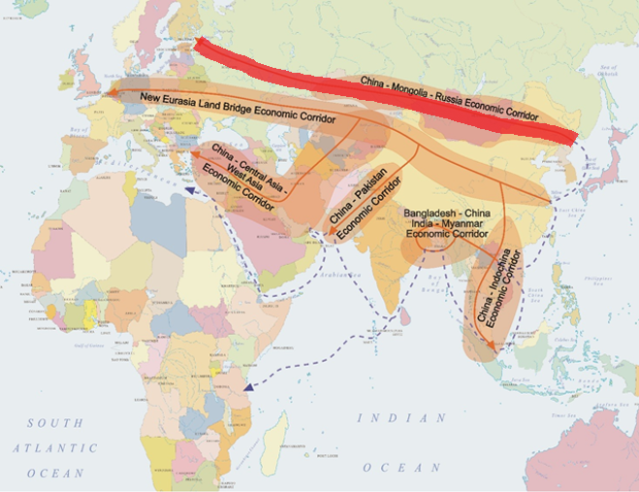
 CPEC  KARACHI CITY &  BUSINESS EDUCATION: How to connect the Three Dots Remarks by Dr Ijaz Shafi Gilani, (February.05, 2018 Karachi)
Mega-Corridor
Source: China Trade Research

Slide 26
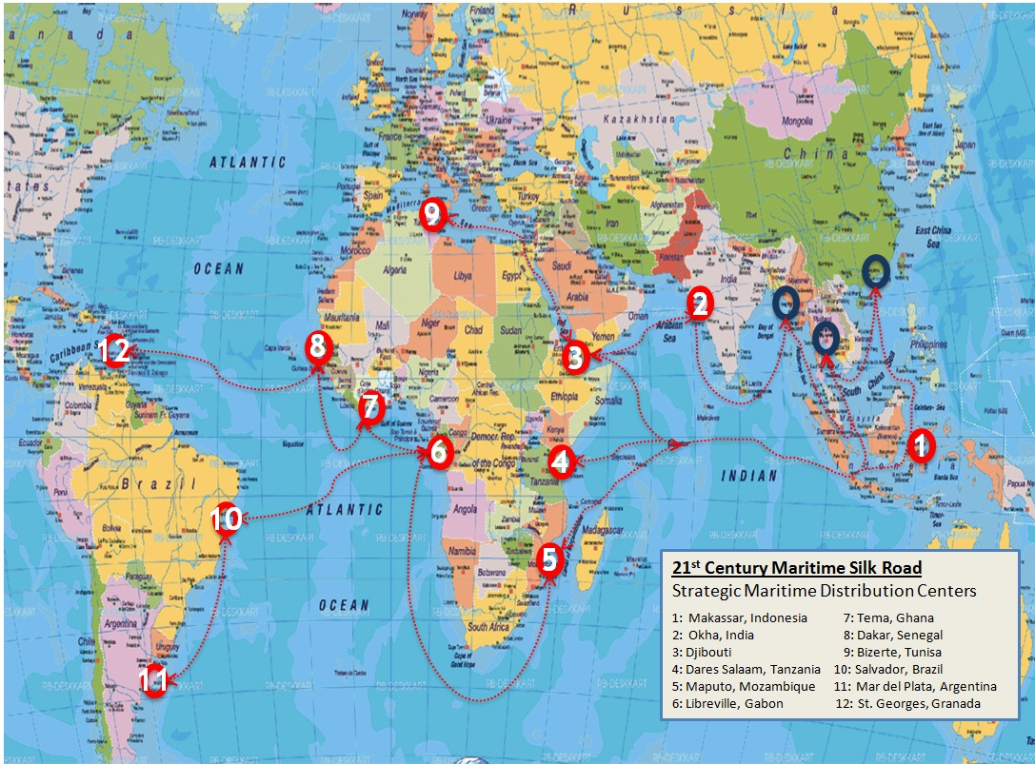
 CPEC  KARACHI CITY &  BUSINESS EDUCATION: How to connect the Three Dots Remarks by Dr Ijaz Shafi Gilani, (February.05, 2018 Karachi)
Further Details of Southern Mega-Corridor
Source: China Trade Research

Slide 27
Fortunately
 CPEC  KARACHI CITY &  BUSINESS EDUCATION: How to connect the Three Dots Remarks by Dr Ijaz Shafi Gilani, (February.05, 2018 Karachi)
CPEC HAS BEEN POSITIONED BY CHINA AS A FLAGSHIP-TEST CASE OF OBOR-BRI

Slide 28
 CPEC  KARACHI CITY &  BUSINESS EDUCATION: How to connect the Three Dots Remarks by Dr Ijaz Shafi Gilani, (February.05, 2018 Karachi)
The City of KARACHI

Slide 29
 CPEC  KARACHI CITY &  BUSINESS EDUCATION: How to connect the Three Dots Remarks by Dr Ijaz Shafi Gilani, (February.05, 2018 Karachi)
The Left Behind GLOBAL METROPOLITAN CITY

Slide 30
Dialectic # 5
 CPEC  KARACHI CITY &  BUSINESS EDUCATION: How to connect the Three Dots Remarks by Dr Ijaz Shafi Gilani, (February.05, 2018 Karachi)
LEFT BEHIND CAN BECOME THE FRONT RUNNER

Slide 31
 CPEC  KARACHI CITY &  BUSINESS EDUCATION: How to connect the Three Dots Remarks by Dr Ijaz Shafi Gilani, (February.05, 2018 Karachi)
THE UN-TAPPED GIVES THE HIGHEST RETURNS IF YOU CAN TAP THE UN-TAPPED

Slide 32
 CPEC  KARACHI CITY &  BUSINESS EDUCATION: How to connect the Three Dots Remarks by Dr Ijaz Shafi Gilani, (February.05, 2018 Karachi)
HOW TO CONNECT KARACHI AND CPEC

Slide 33
CEPEC.1
 CPEC  KARACHI CITY &  BUSINESS EDUCATION: How to connect the Three Dots Remarks by Dr Ijaz Shafi Gilani, (February.05, 2018 Karachi)
China Pakistan Economic Corridor is half way through
KARACHI HAS HAD ONLY A MODEST SHARE

Slide 34
CEPEC.2
 CPEC  KARACHI CITY &  BUSINESS EDUCATION: How to connect the Three Dots Remarks by Dr Ijaz Shafi Gilani, (February.05, 2018 Karachi)
CHINA PAKISTAN ECONOMIC COOPERATION
(Corridor was in some way a misnomer)
KARACHI SHOULD BE IN THE LEAD

Slide 35
 CPEC  KARACHI CITY &  BUSINESS EDUCATION: How to connect the Three Dots Remarks by Dr Ijaz Shafi Gilani, (February.05, 2018 Karachi)
ONE YEAR ECONOMY OF KARACHI IS TWICE AS BIG (at least)
AS THE 10 YEAR CPEC.1
Afterall 50 Billion USD is only (less than) 25 USD Per Pakistan; 50 Billion USD over 10 years is (less than) 2.5 USD per Pakistani per year.
Hence Cpec.1 is only a door-opener

Slide 36
 CPEC  KARACHI CITY &  BUSINESS EDUCATION: How to connect the Three Dots Remarks by Dr Ijaz Shafi Gilani, (February.05, 2018 Karachi)
Suggest we conceive of and position
CPEC.1
AS ONLY A FACILITATOR OF
CPEC.2
TO HARNESS THE OPPORTUNITY WITHIN PAKISTAN
TO POSITION PAKISTAN AS CHINA'S PARTNER IN GLOBAL INFRASTRUCTURE-Hardware of connectivity-REVOLUTION

Slide 37
 CPEC  KARACHI CITY &  BUSINESS EDUCATION: How to connect the Three Dots Remarks by Dr Ijaz Shafi Gilani, (February.05, 2018 Karachi)
CAN KARACHI RISE TO THE OCCASION AND LEAD CPEC.2 AND PLAY ITS ROLE AS PAKISTAN'S TOP CITY

Slide 38
 CPEC  KARACHI CITY &  BUSINESS EDUCATION: How to connect the Three Dots Remarks by Dr Ijaz Shafi Gilani, (February.05, 2018 Karachi)
CAN KARACHI BE THE LEADER OF CORPORATELY GOVERNED TOP 30 CITIES OF PAKISTAN
To use a
KARACHI.INC (Metaphor)

Slide 39
 CPEC  KARACHI CITY &  BUSINESS EDUCATION: How to connect the Three Dots Remarks by Dr Ijaz Shafi Gilani, (February.05, 2018 Karachi)
CAN BUSINESS SCHOOLS FROM ACROSS PAKISTAN HELP THEIR PREMIER CITY SHOULD KARACHI DECIDE TO TAKE THAT PATH

Slide 40
 CPEC  KARACHI CITY &  BUSINESS EDUCATION: How to connect the Three Dots Remarks by Dr Ijaz Shafi Gilani, (February.05, 2018 Karachi)
?

Slide 41
THANK YOU

